Slide 1
Programming For Everyone!!
Introductions and a Warm Welcome!!

Slide 2
Table of contents
01
02
03
04
05
06
DEV3LUP and our Goals
What is Python
Where is Python used
IDLE
Interpreter vs Compiler
Activity

Slide 3
Welcome to DEV3LUP!!
Our goal is to have a space for discussions about computing and anything tech-related in general.
This course, Programming for Everyone, is aimed at making programming accessible to anyone regardless of what major or year they are in.
We will be learning Programming basics with Python.
Once we are done with the basics, we will be learning some libraries that showcase the different ways we can use the language.

Slide 4

01
Introduction

Slide 5

What is Python?
Python is a high-level programming language created by Guido Van Rossum and first released in 1991.
Its popularity has grown over the years and as of 2023 it was the 3rd most popular language.

Slide 6
Developers often prefer python over other languages because:
1. It’s portable, meaning its supported on different operating systems.
2. It's easy to understand
3. Has built-in functions that reduce code size
4. Is multi-purpose i.e. is used to perform various forms of tasks.

Slide 7
Where is Python used?
Python is used to perform a variety of tasks such as:
1. Create web applications
2. Connect to database systems to create, read and modify files.
3. Handling big data and perform complex math
4. Automating tasks and much more !

Slide 8
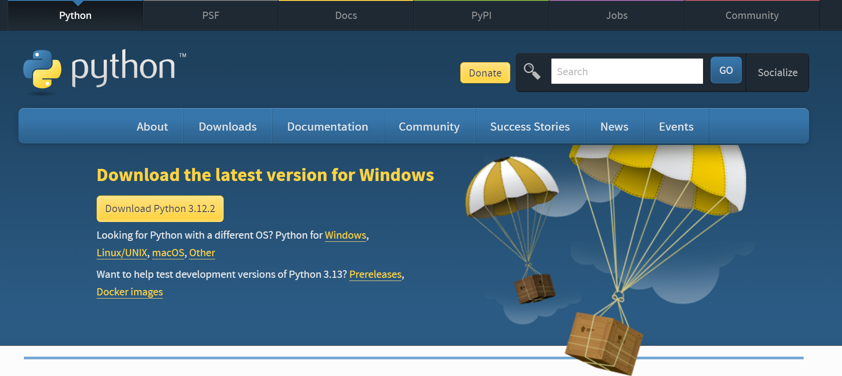
How to install?
Download Python | Python.org⁤

Slide 9
Introduction to IDLE
IDLE is the default text editor to write python code.
It has two parts:
1.Interpreter
2.Compiler

Slide 10
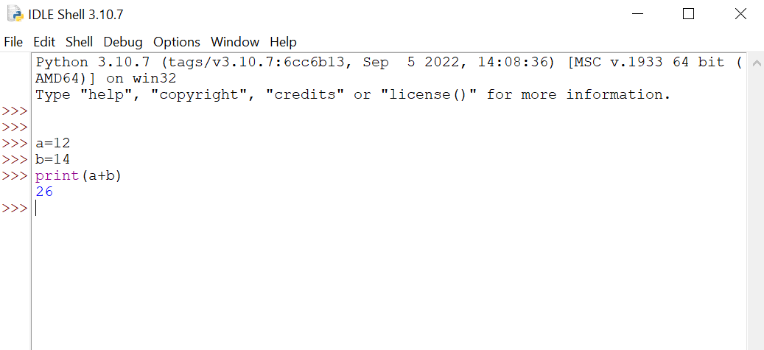
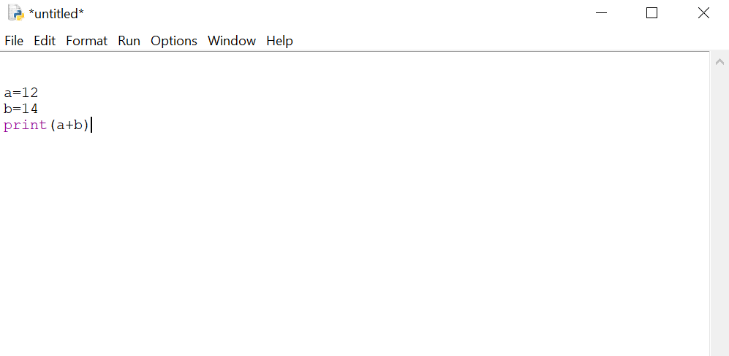
Interpreter
Compiler

Slide 11
Interpreter vs Compiler
The main difference between an interpreter and a compiler is that an interpreter executes code line-by-line while the compiler as the word says compiles the whole code and then executes it.
When we open IDLE the interpreter opens up. This is what we will be playing with first.
By clicking the File tab and then the 'New File' option, we will get the compiler.

Slide 12
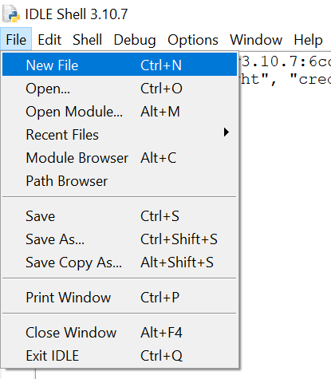
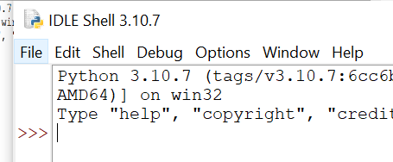
How to use the compiler

Slide 13
Syntax
>>> print("Hello, World!")
Hello, World!
>>> 5 > 2
True
>>> x = 5
Y = “Hello, World!”

Slide 14
print() function
The print() function is used to display a prompt to the user.
It works by calling the keyword “print” and encapsulating the prompt within parenthesis.
Eg:
print(“Hello World!”)
x = "Python is awesome"
print(x)
In the print() function, you output multiple variables, separated by a comma:
x = "Python"
y = "is"
z = "awesome"
print(x, y, z)
Output:
Hello World!
Python is awesome
Output:
Python is awesome

Slide 15
Variables
Variables are containers for storing data values.
Variables do not need to be declared with any particular type, and can even change type after they have been set.
Variable names are case-sensitive.

Slide 16
Creating Variables
Python has no command for declaring a variable.
A variable is created the moment you first assign a value to it.
Example:
x = 5
y = "John"
print(x)
print(y)
Example:
x = 4 # x is of type int
x = "Sally" # x is now of type str
print(x)

Slide 17
Variable Names
A variable can have a short name (like x and y) or a more descriptive name (age, carname, total_volume). Rules for Python variables:
A variable name must start with a letter or the underscore character
A variable name cannot start with a number. Eg. 2myvar= "John”
A variable name can only contain alphanumeric characters and underscores (A-z, 0-9, and _ )
Variable names are case-sensitive (age, Age and AGE are three different variables)
A variable name cannot be any of the Python keywords.
Example:
myvar = "John” my_var = "John” _my_var = "John”
myVar = "John” MYVAR = "John” myvar2 = "John”

Slide 18
Built in Data Types
In programming, data type is an important concept. Variables can store data of different types, and different types can do different things. Python has the following data types built-in by default, in these categories:
Text Type: str
Numeric Types: int, float
Sequence Types: list, tuple, range
Mapping Type: dict
Set Types: set
Boolean Type: bool
Binary Types: bytes
None Type: None Type

Slide 19
Activity
Task 1: Display your:
Name
Age
Course
P-number

Slide 20
What libraries will we learn?
Matplotlib: Matplotlib is a comprehensive library for creating static, animated, and interactive visualizations in Python. [1] (Visualization with python, 2012)
BeautifulSoup: Beautiful Soup is a library that makes it easy to scrape information from web pages.
[2] (Beautifulsoup4, 2024)
PyAutoGUI : PyAutoGUI is a cross-platform GUI automation Python module, used to programmatically control the mouse & keyboard.
[3] (Pyautogui, 2024)

Slide 21
Thanks!
Do you have any questions?

Slide 22
References
[1] The Matplotlib development team (2012) Visualization with python, Matplotlib. Available at: https://matplotlib.org/ (Accessed: 10 March 2024).
[2] PYPI (2024) Beautifulsoup4, PyPI. Available at: https://pypi.org/project/beautifulsoup4/ (Accessed: 11 March 2024).
[3] PYPI (2024) Pyautogui, PyPI. Available at: https://pypi.org/project/PyAutoGUI/ (Accessed: 11 March 2024).

